Slide 1


Microsoft Graph .NET SDK
2023
From Zero to Hero
27/05/2023

Slide 3
About Me

Slide 4
What is Microsoft Graph API?

Slide 5
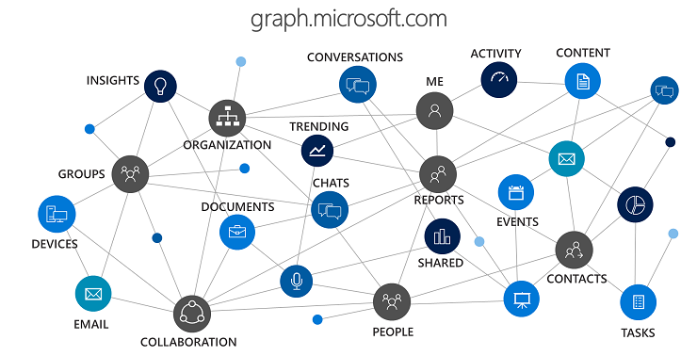

Slide 6
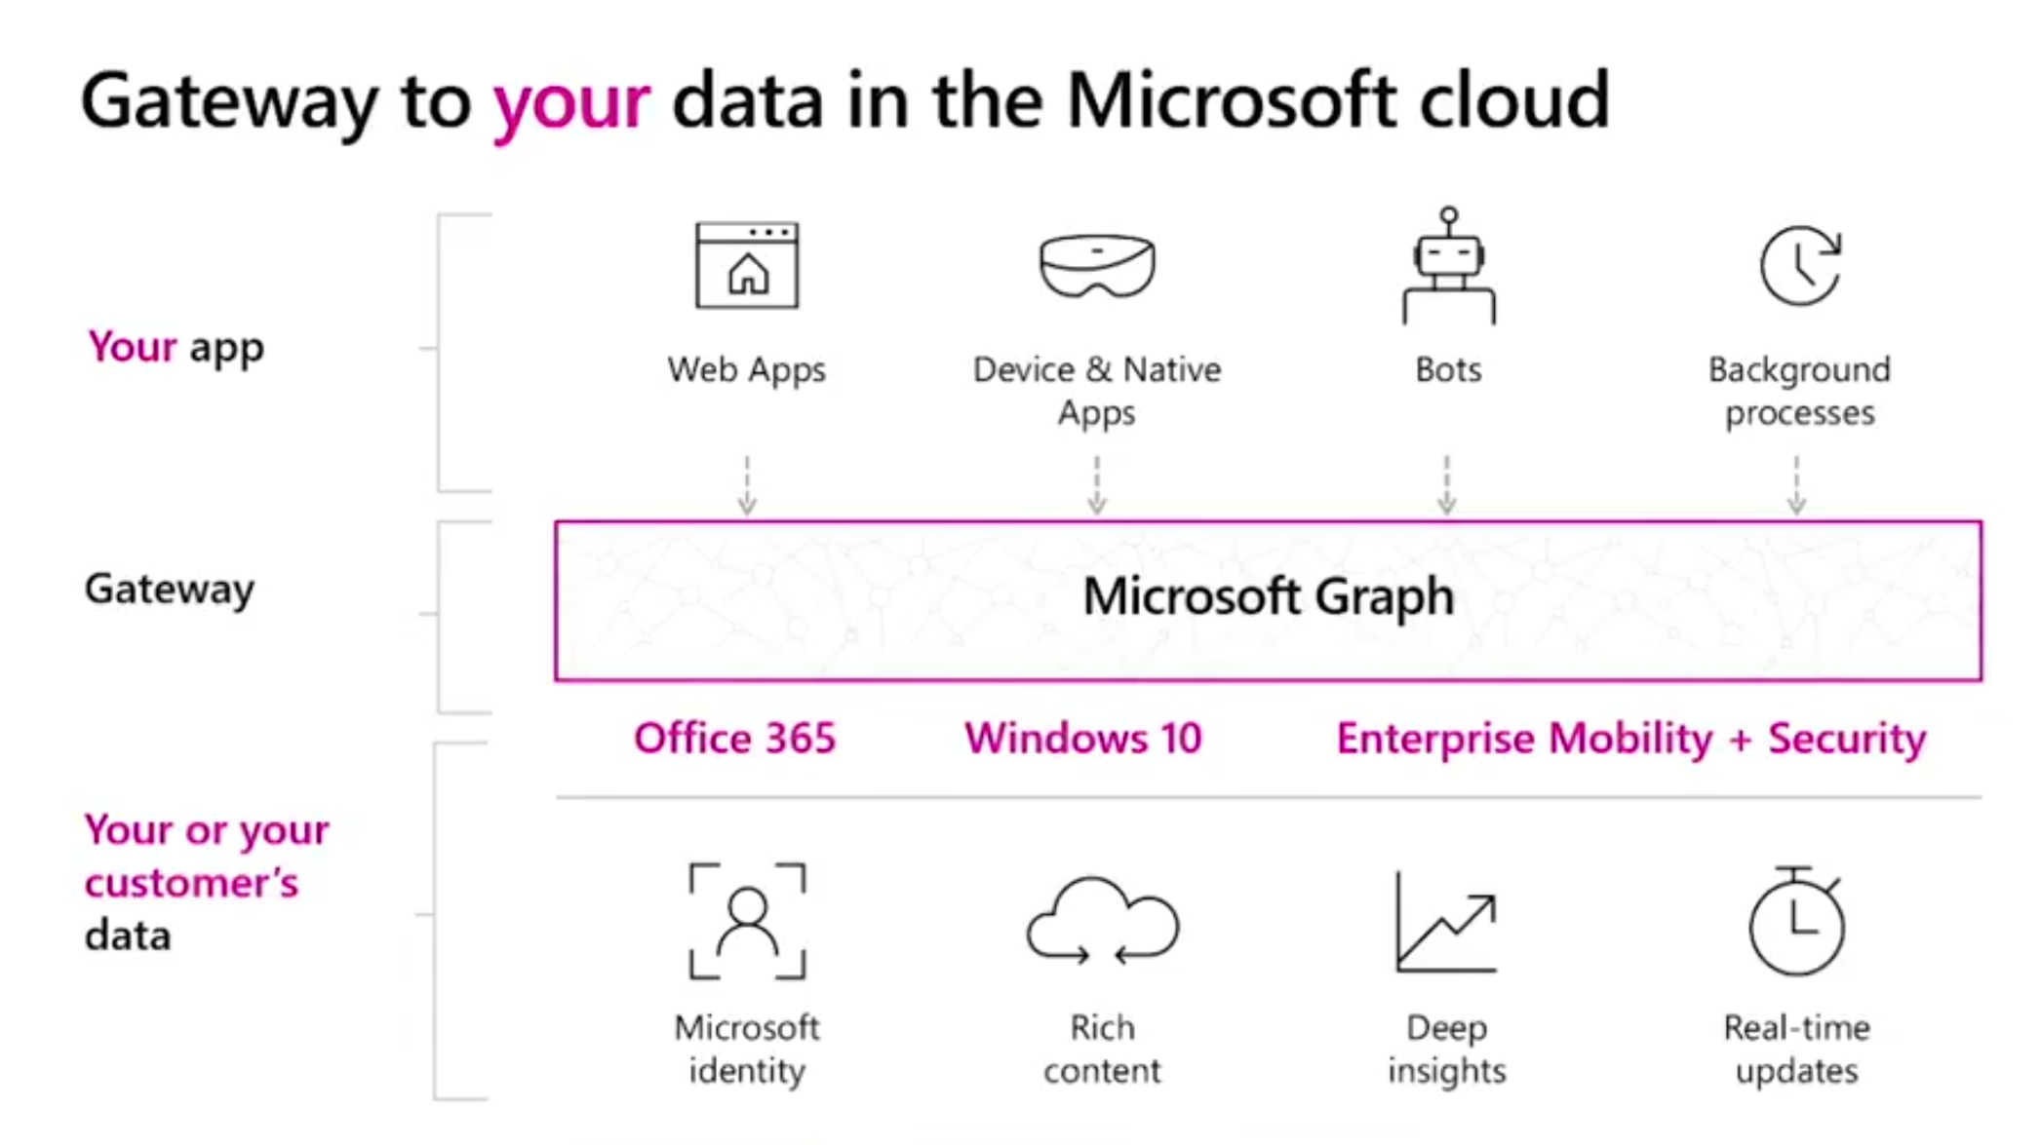

Slide 7
MS Graph SDK Packages

Slide 8
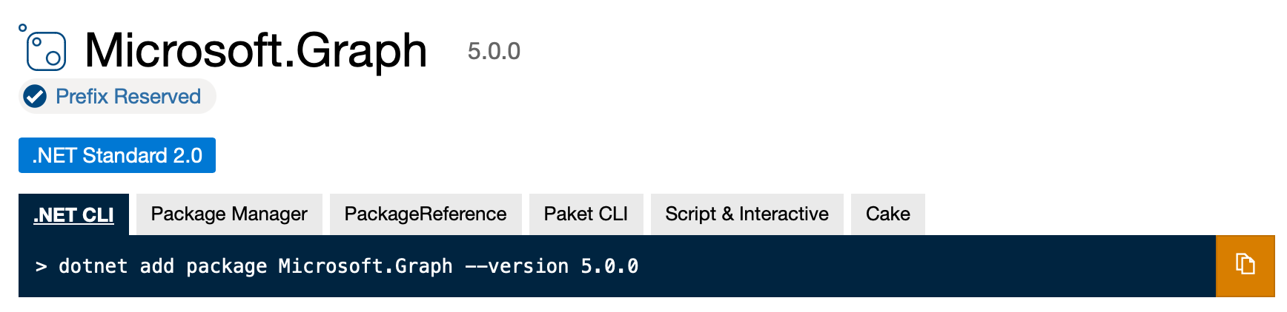
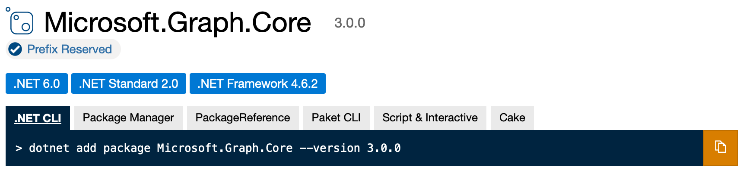
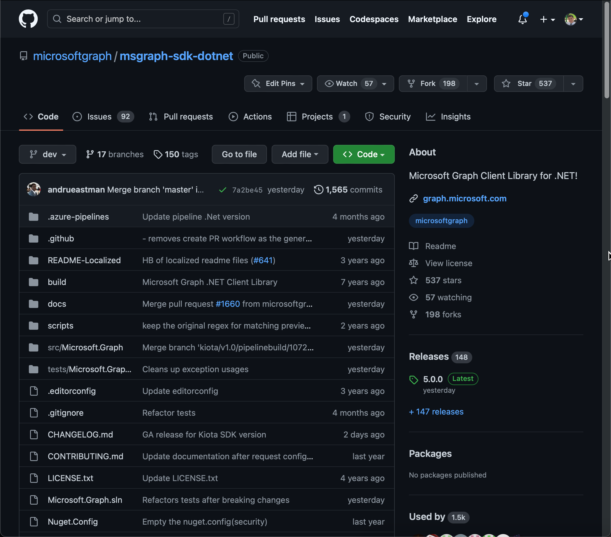
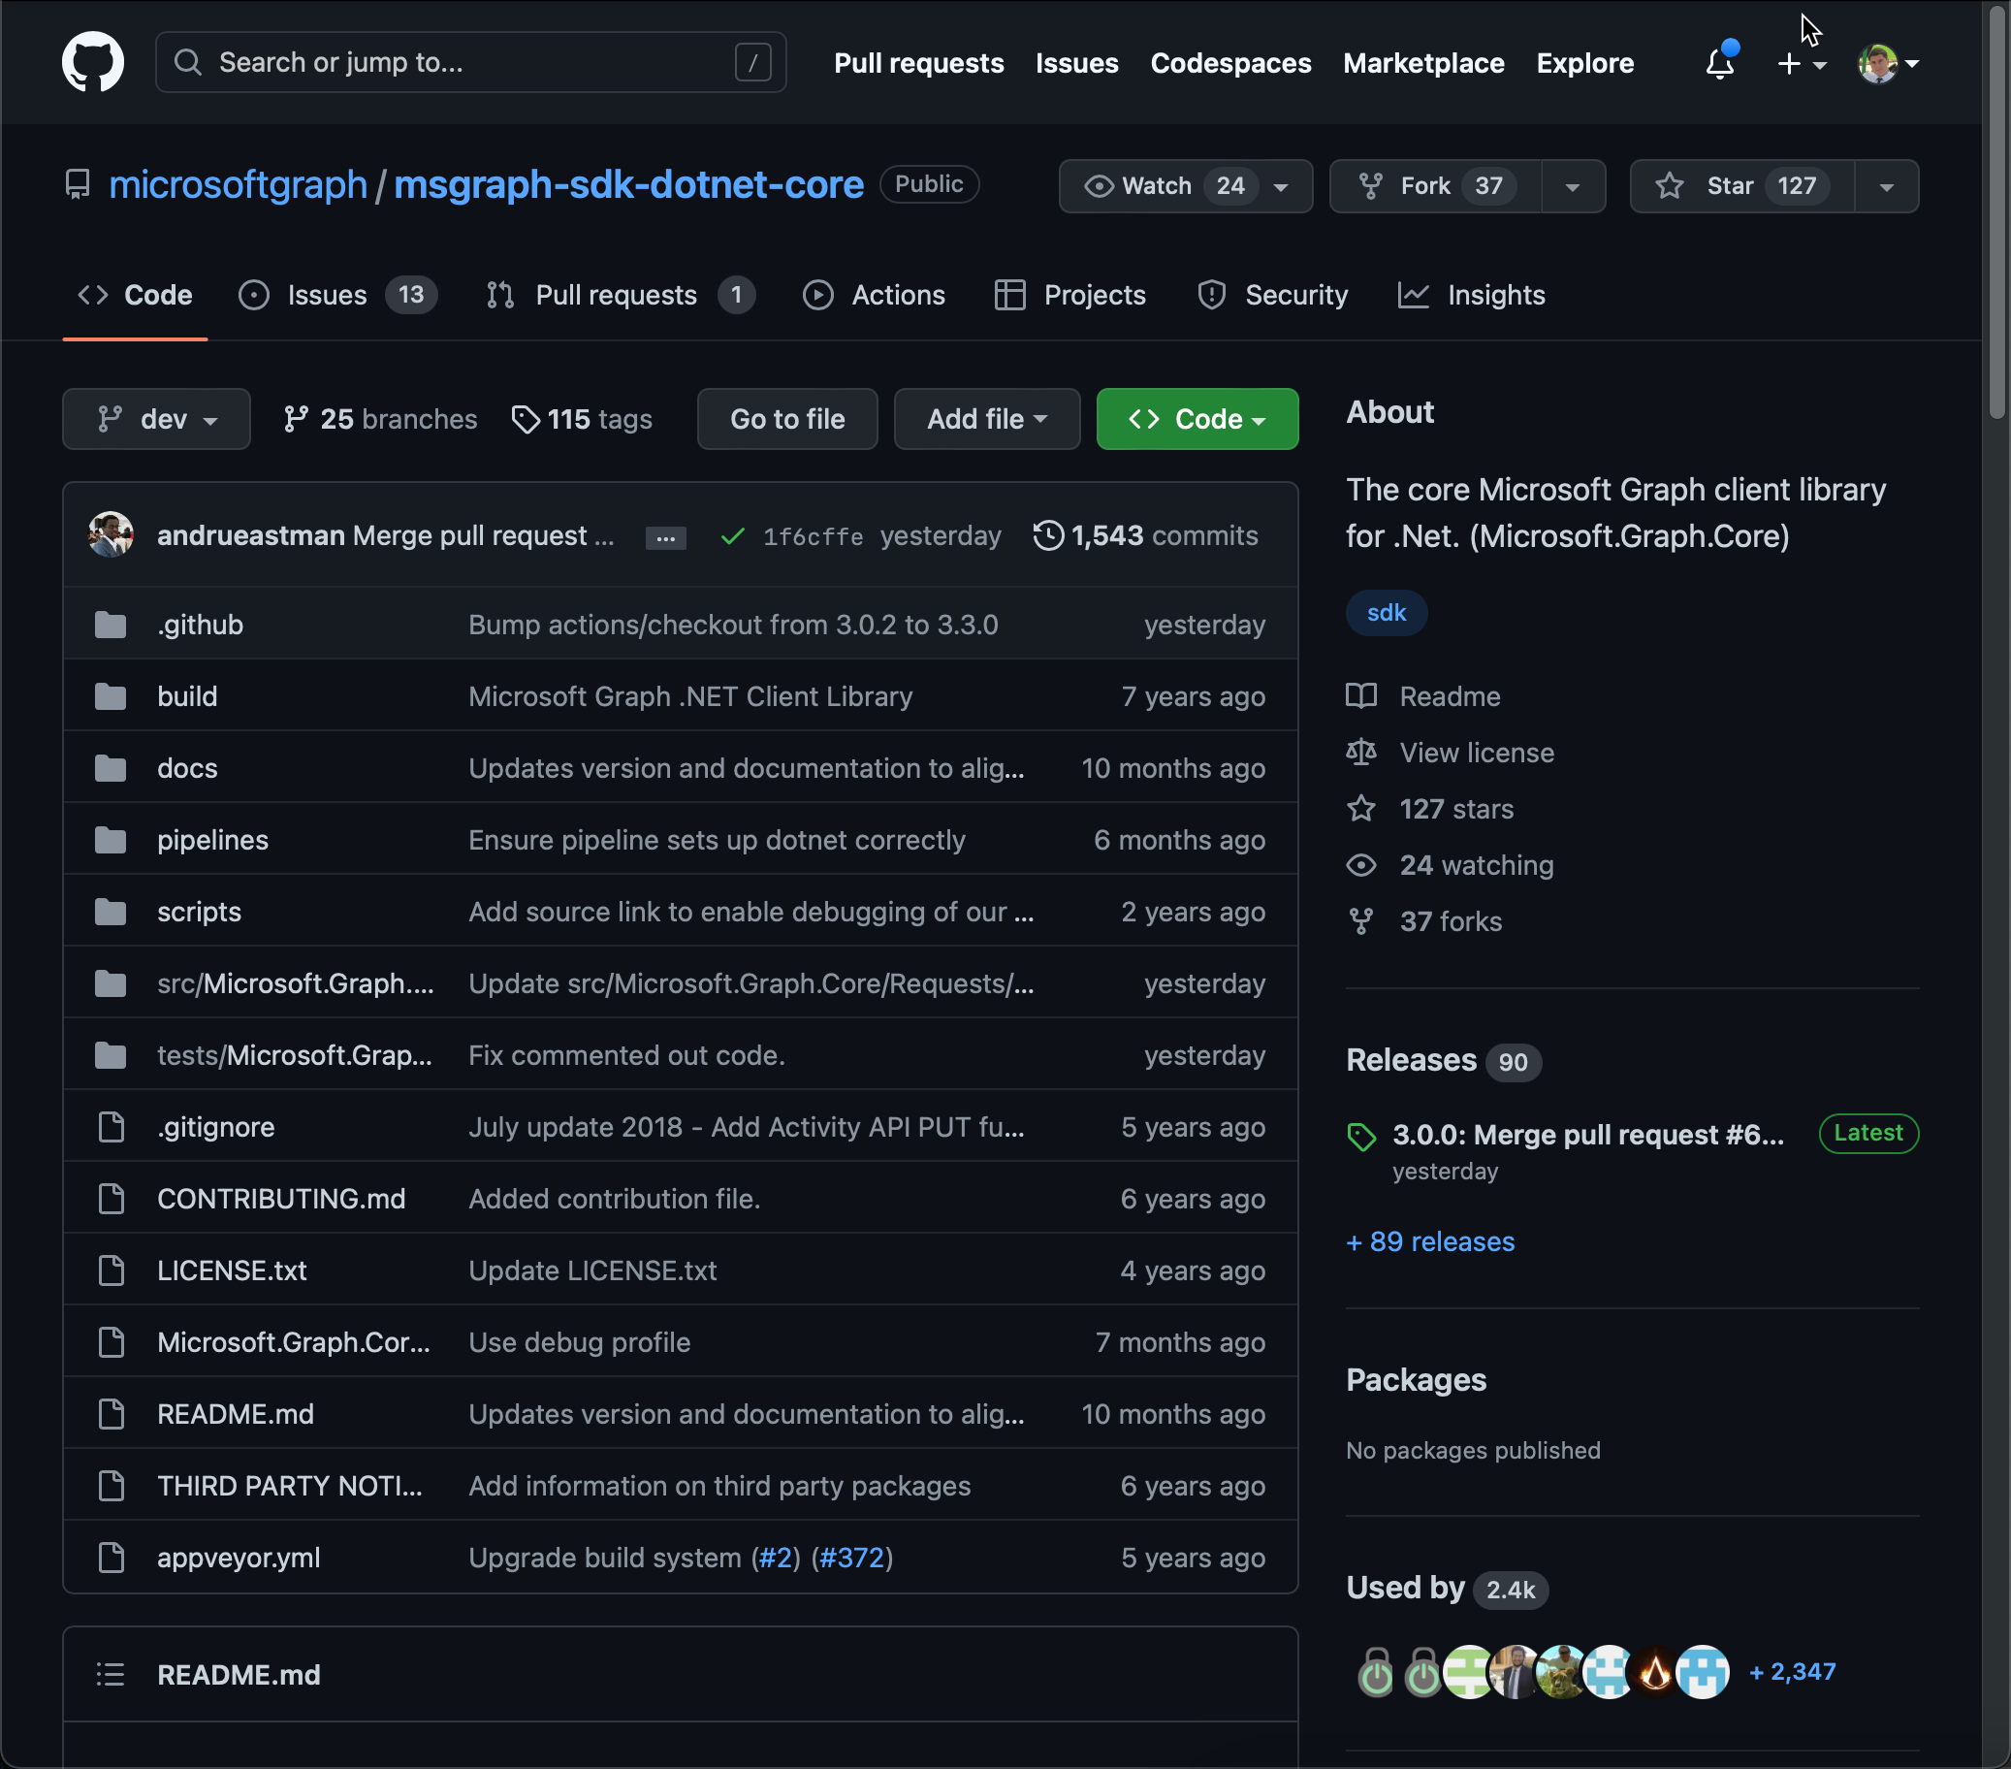
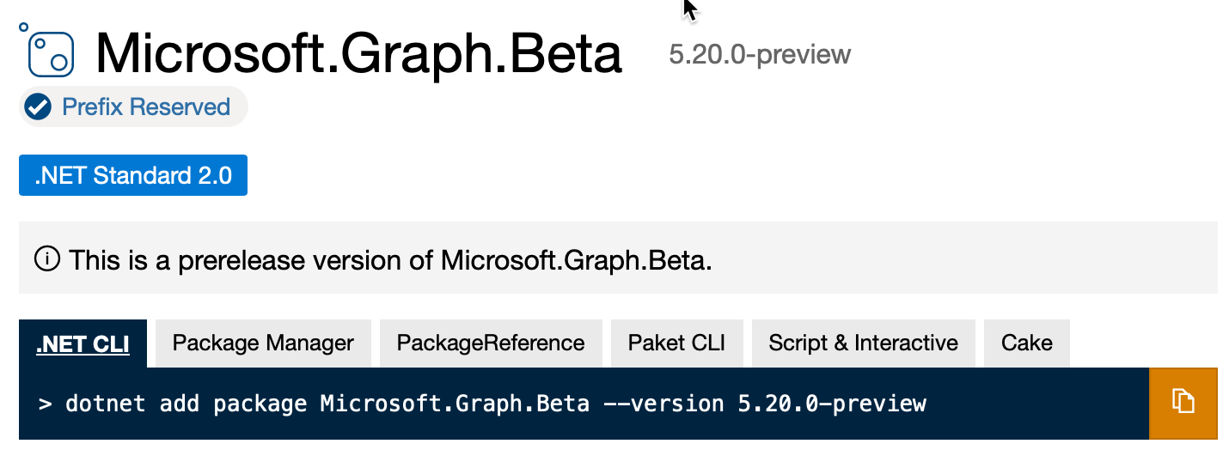
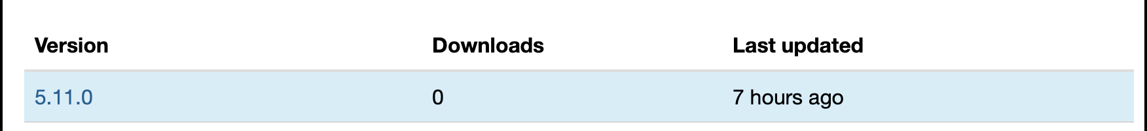

Slide 9
kiota generated !!

Slide 10
MS Graph SDK v5 upgrade log
https://github.com/microsoftgraph/msgraph-sdk-dotnet/blob/dev/docs/upgrade-to-v5.md

Slide 11
MS Graph SDK Authentication

Slide 12
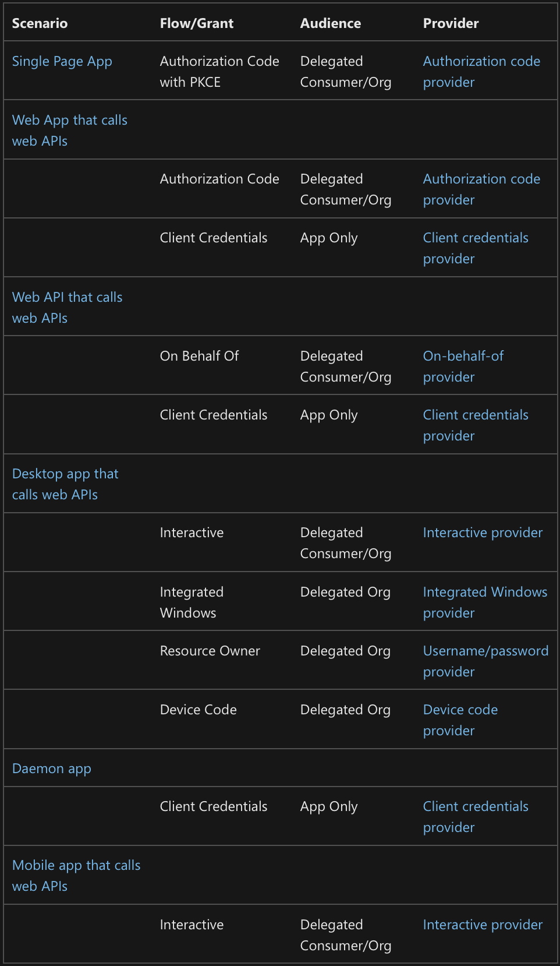
https://learn.microsoft.com/en-us/graph/sdks/choose-authentication-providers?tabs=CS

Slide 13
Let´s Dive In!

Slide 14
https://github.com/luismanez/netcoreconf-malaga-2023

Slide 16
More information:
info@netcoreconf.com
@Netcoreconf
Visit on:
netcoreconf.com
Thanks

